Slide 1
CAPSTONE PROJECT
Kenneth Chew
General Assembly- Data Science Immersive 8

Slide 2
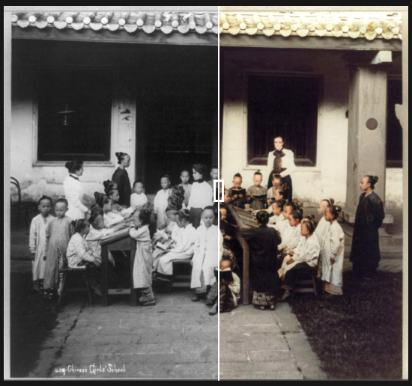
CAPSTONE IDEA no.1
Problem statement
To colorise non-colored pictures and bring new perspective to old pictures with color.
Goals
To create a deep learning model using transfer learning from existing CNN models to learn how pictures are colored and reverse engineer onto greyscale pictures
Gives images more personality/character
Easier to notice things of contrasting colors

Slide 3
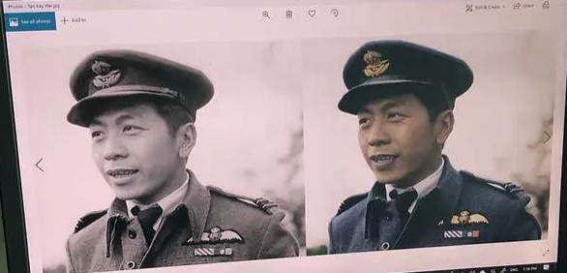
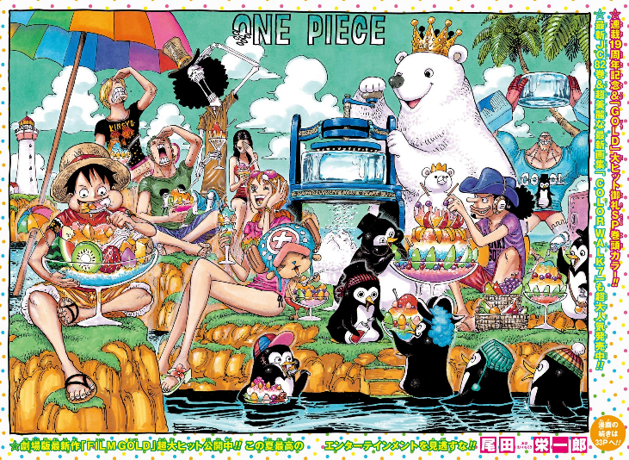
Potential Audience
The art community
Old National Gallery records/paintings/pictures
National Heritage Board
National Museums
Comic community
B/W comics to color

Slide 4
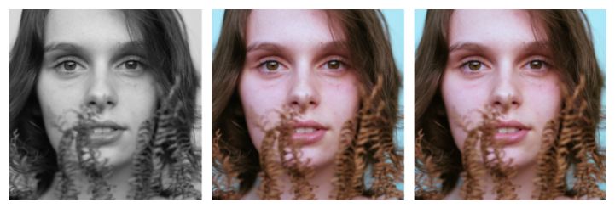
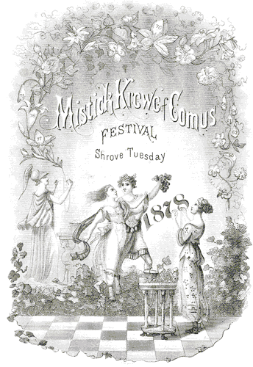
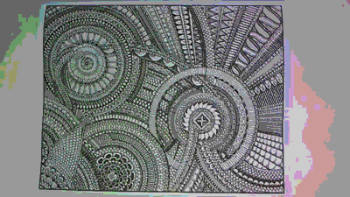
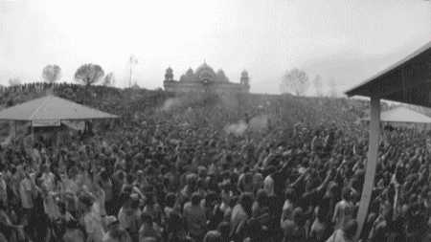
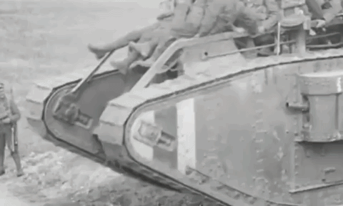
Success metric
Data Sources
1) Unsplash (10,000 pictures)
2) ImageNet (5 to 10 categories)

Slide 5
CAPSTONE IDEA no.2
Problem statement
To predict calories from image of food
Potential Audience
Anyone and everyone who should be health-conscience about the food they take
Goals
To create a CNN model that will determine the food item’s category and using a volume calculation on the localisation matrix to predict calories based on density
Success Metrics
Help people keep track of their calories intake and keeping people fit

Slide 6
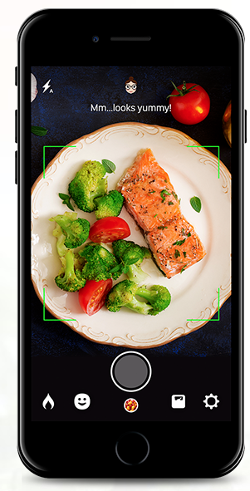
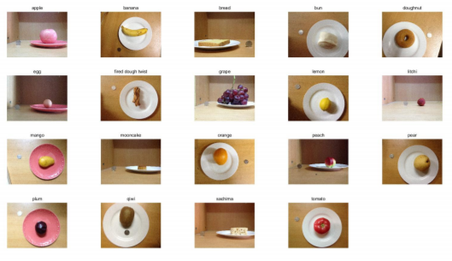
Datasets
https://pan.baidu.com/s/1o8qDnXC
19 Food categories of 2978 images; Top and side view of food
Food density and to calculate volume

Slide 7
CAPSTONE IDEA no.3
Problem statement
To detect toxic/unhelpful content to improve online conversations/forums
Potential Audience
Any online forums or conversational platforms such as Quora
Goals
To create classification model based to look at people’s conversation and see if their words are helpful or just disparaging or inflammatory/false.
Success Metrics
Accuracy of classification

Slide 8

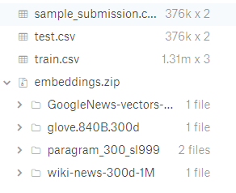
Datasets
Data source: Kaggle
Data shape:
1.31 million rows, 3 columns

Slide 9
References
Sim, Fann (2018, December 30). Bringing Singapore's history to life with a splash of colour. Retrieved from https://www.channelnewsasia.com/news/singapore/singapore-digital-colourist-black-white-historical-photos-11065906
Wallner, Emil (2017, October 29). How to colorize black & white photos with just 100 lines of neural network code. Retrieved from https://medium.com/@emilwallner/colorize-b-w-photos-with-a-100-line-neural-network-53d9b4449f8d
Liang, Y., & Li, J. (2017). Computer vision-based food calorie estimation: dataset, method, and experiment. arXiv preprint arXiv:1705.07632.
Kaggle competition. (2019, June 19). Retrieved from https://www.kaggle.com/c/quora-insincere-questions-classification/data.

